Slide 1


Enterprise Intelligence Development Project
PIMA Indians Dataset
Classification Problem
Akshay Jadhav
November 30, 2020

Slide 2

Agenda
Introduction
Objectives and Approach
Insights and trends
Predictive Modeling
Challenges/Limitations
Importance of attributes
Recommendations
Future Scope

Slide 3

Introduction
PIMA Indians are a group Native American people who lives in the Phoenix, Arizona. So many years, these people are are living with poor diet which where carbohydrate deficiency seems more and in turn, they are exposed to type 2 diabetes among children as well as adults.
To deal with such a huge and deadly disease, many Medicare organizations are trying to achieve their best possible solutions to diagnose the diabetes among children as well as adults to mitigate the risk of diabetes in the future, to reduce the period required for diagnosis with exact identification of people having diabetes as fast as possible, and to provide proper treatment for diabetic people for a reduction in the severity of complications associated with this disease.

Slide 4
Objectives
Client wants to make the best decision on a business problem of classifying the right number of people who have diabetes and who do not have diabetes to invest valuable time towards the proper treatment of diabetic patients rather than in diabetes testing.
Based on the business problem, project forecasts incorporates valuable research,
Data analysis and visualization on the PIMA Indians diabetes data to find valuable insights to provide more exposure to various important factors and their contribution
Building predictive algorithms to identify a person has diabetes or not
Justification and necessary medical attributes contributing to identifying a person as a diabetic
Recommendation for client

Slide 5
Approach
Data analysis and visualization on the PIMA Indians diabetes data to find valuable insights to provide more exposure to various important factors and their contribution
Statistical Descriptive Analysis
Exploring trends and patterns in the data
Correlations between various medical attributes of a person in the data
Building predictive algorithms to identify a person has diabetes or not
Based on findings and results the PIMA Indians diabetes data, we would best classify the people having diabetes from non-diabetic people
Justification and necessary medical attributes contributing to identifying a person as a diabetic
Based on classification observed by algorithm for the data, we would strongly justify our classified diabetic people from non-diabetic people with vital medical attributes
Recommendation for Client
Based on classification results between diabetic or non-diabetic people, we would recommend client with the best possible actions on a business problem and how to deal with it in intermediate years in medicare industry.
PIMA Indians Diabetes Dataset:
https://github.com/akshayjadhav21/CS666_Project_Datasets.git

Slide 6
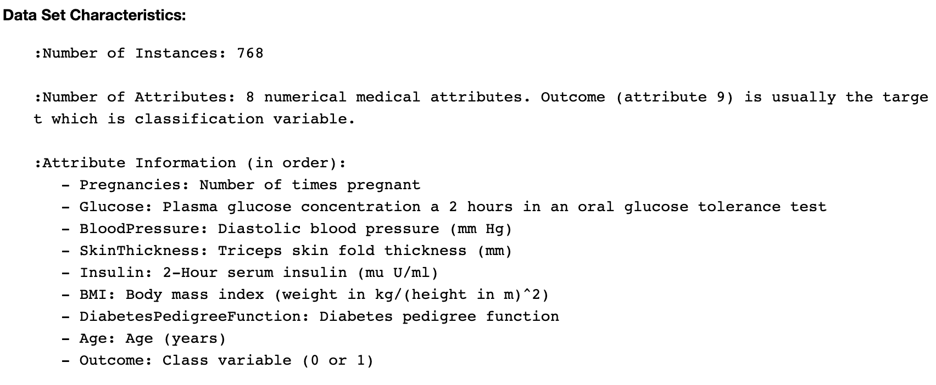
Insights & Trends
General Description

Slide 7
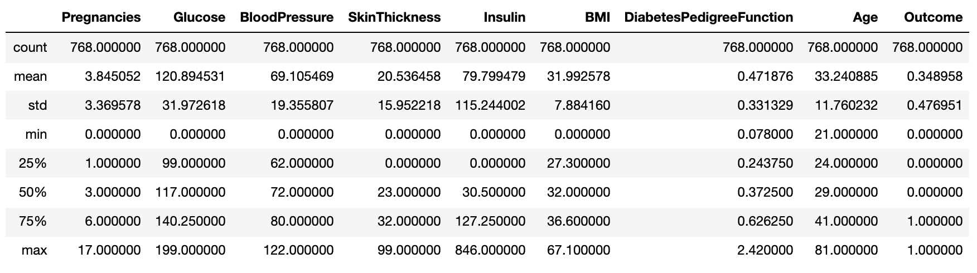
Insights & Trends
Statistical Description
Findings:
Except Insulin, DiabetesPedigreeFunction, and Age (Left Skewed), all other attributes seems normally distributed in nature.
We should be more focused on BloodPressure, Glucose, SkinThickness, BMI because its minimum values are irrelevant in real practice.

Slide 8
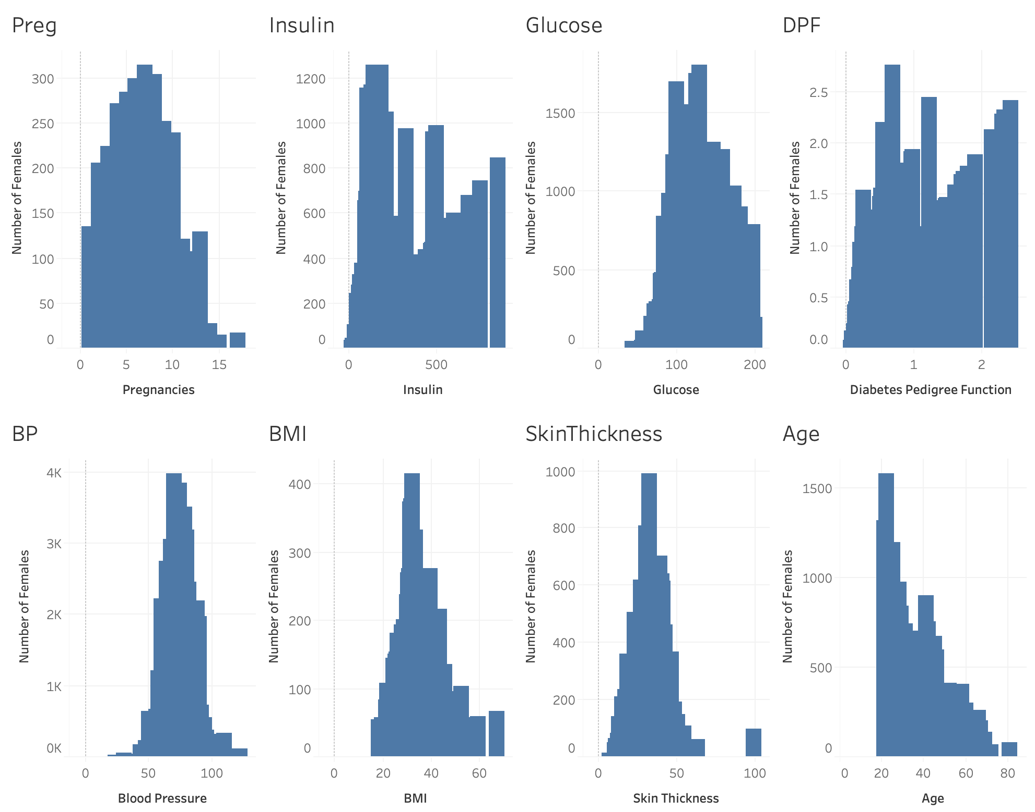
Insights & Trends
Distribution of each attribute

Slide 9
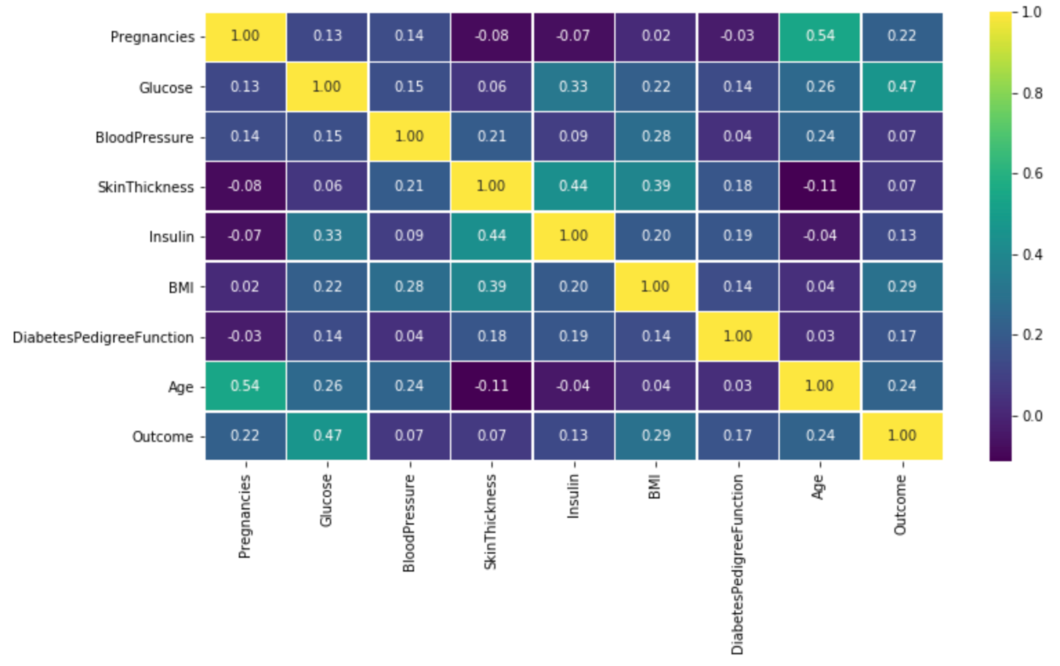
Insights & Trends
Correlation between attributes

Slide 10

Insights & Trends
Based on above correlations, the following attributes/factors are having some meaningful and valuable correlations,
Glucose is correlated with outcome than any other attributes in the data. (47%)
Age is correlated with Pregnancies than any other attributes in the data. (54%)
Findings:
We should be more focused towards the above highly correlated attributes (Glucose, Age, and Pregnancies) while predicting a diabetic people.
Based on distribution of the attributes, we should be more focused on Age, SkinThickness, Pregnancies, BloodPressure, and BMI because they might have irrelevant values (out-of-boundary values).

Slide 11

Insights & Trends
Based on above statistical observations, correlations, and found insights, all the present attributes are important in further predictive analytics or modeling to classify the diabetic people from non-diabetic people in real practice.
Let’s do some predictive modeling to build a system
or algorithm which will help our client in classifying diabetic
people from non-diabetic people and recommending
the best way to classify the people as fast as possible
to streamline the diagnostic process.
NOTE: We have performed necessary data preparation
which would be useful in increasing prediction accuracy
of the algorithm.

Slide 12
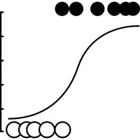
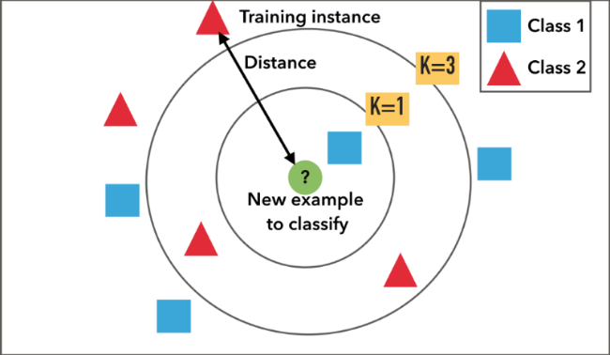
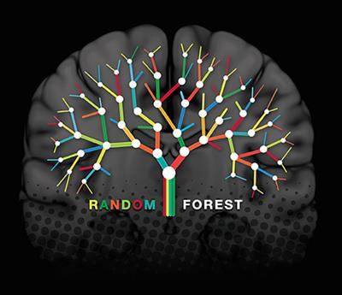
Predictive Modeling
We have built Logistic Regression, K-Nearest Neighbor, and Random Forest classification predictive algorithm to classify the diabetic people from non-diabetic people based on various factors/attributes such as, Glucose, Age, BMI, BloodPressure, SkinThickness, Insulin, Pregnancy, and DiabetesPedigreeFunction.
Logistic Regression
K-Nearest Neighbor
Random Forest
Accuracy rate:
74% (Good)
Accuracy rate:
78% (Good)
Accuracy rate:
82% (Best)

Slide 13
Predictive Modeling
Findings
Based on above prediction modeling observations, client would be able to best classify the diabetic people from non-diabetic people by using best accurate predictive algorithm which is Random Forest Classifier.
We have achieved accuracy rate of 82% i.e. performance measure which can be used to measure the performance of the model in identifying diabetic people from non-diabetic people.
The random forest algorithm was trained, tested, and evaluated with so many different chunks of the data so client would make prediction on new unseen data for classification of people with more confidence.

Slide 14
Challenges or Limitations
Removing odd values / outliers
During data analysis phase, we have got many values of input variables or factors are randomly distributed with some values are way far away from other set of values.
Such a disperse of values would have caused problems in classifying diabetic people from non-diabetic people if not eliminated at the right time.
We have removed the values which are out of 3rd standard deviation which generally used to detect and remove outliers, but we have found dispersed data points within 3rd standard deviation of the data distribution which are required, and we can not remove them.
HyperParameter Tuning
We had to do a lot of iterations on selecting the best parameters to train the algorithm using methods such as GridSearchCV, RandomizedSearchCV, and Elbow method.
Specifically, we had required intensive work on elbow method to select the best possible K (Nearest Neighbor) value which provide lower error rate with higher accuracy performance.
Irrelevant values of attributes
We have found there are more than one attributes such as BloodPressure, SkinThickness, Glucose, Insulin, and BMI having value equals to zero which are irrelevant in nature in real practice.
So, to eliminate them we had performed transformation of data by removing outlier data such irrelevant zero values.

Slide 15
Importance of attributes
Findings:
In recent years, from 2000 to 2010, the percentage of pregnant women with gestational diabetes increased 56% and the percentage of women with type 1 or type 2 diabetes before pregnancy increased 37%.
Being more than 45 years of age is a risk for type 2 diabetes and because client should have considered the age factor in diagnostic of diabetes.
Along with age and pregnancy, there are various factors/attributes such as SkinThickness, BMI, BloodPressure, Insulin, Glucose level are equally important in identifying a diabetic person.

Slide 16





Recommendations
Such a huge increase in diabetic rate in pregnant women allows client to focus more on pregnancy counts of the females.
Along with pregnancies, client should consider all other attributes which are equally vital in determining the people as a diabetic.
Client must consider higher volume of data to have a better classification of diabetic people from non-diabetic people within a large population.
Based on analysis, client should be more focused on the people with more than 45 years of age which usually help to best identify diabetic people because a greater number of people are from that age range.
Client should be able to make a confident decision based on the performance of evaluated random forest algorithm for identifying diabetic people from non-diabetic people.
Random Forest :
82% Accuracy Rate
Random Forest algorithm can be implemented as a final model.

Slide 17
Future Scope
In the intermediate years, due to increase in risk of diabetes, client would only make a confident decisions for identifying diabetic people by evaluating additional necessary attributes.
Nowadays, due to rapid increase in mental stress, physical stress in urban life, one could be at risk of getting ill immediately reducing necessary medical attributes such BloodPressure, Glucose level, client should be more cautious and smarter about the diagnosis of diabetes.
Client must expose to more recent and high-volume real-time data to test against the trained and evaluated model to check its performance at all levels.
If client wants to predict which diagnostic measures needs to be taken for the people who are diagnosed with diabetes, it would be possible to analyze additional necessary medical attributes for further exploration and to streamline the tedious process of diagnosis.

Slide 18
THANK YOU

